Slide 1
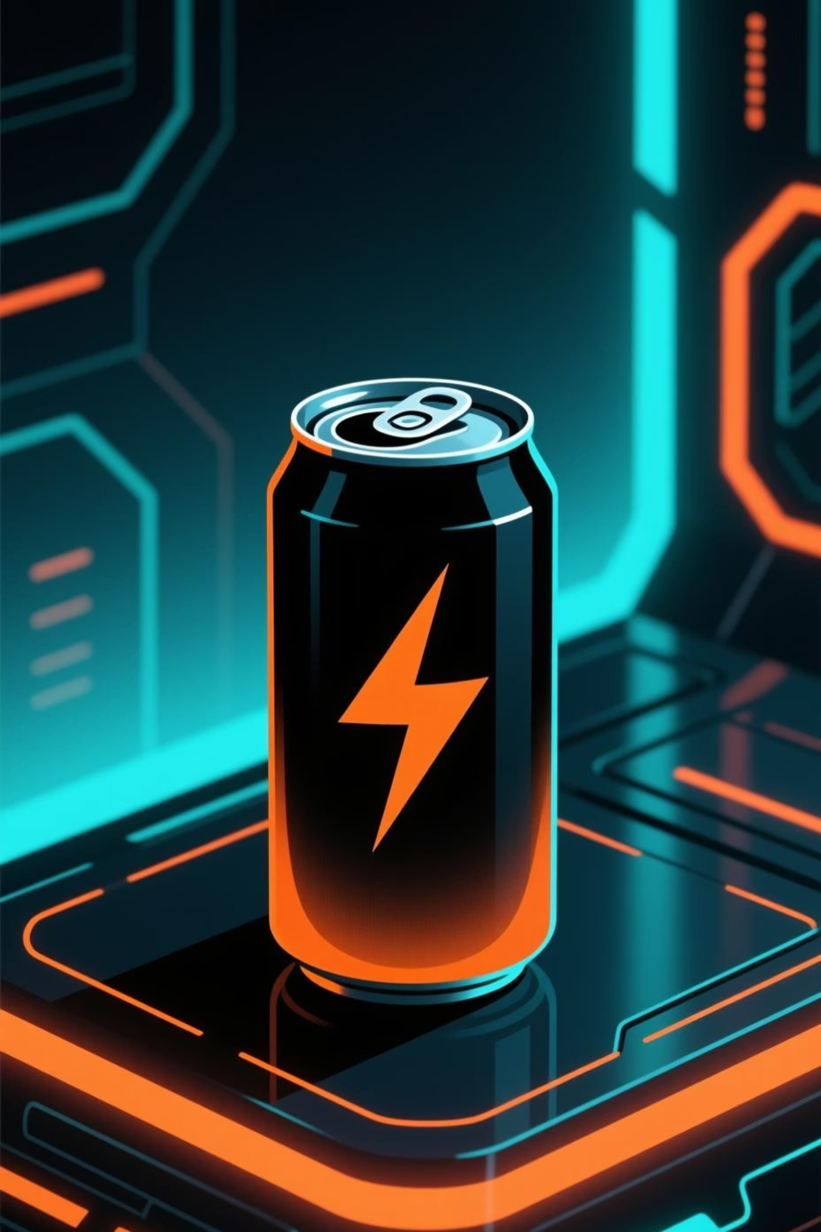
Red Bull Apex Ascent Edition
A Strategic Rebrand for Competitive Gaming Dominance

Slide 2
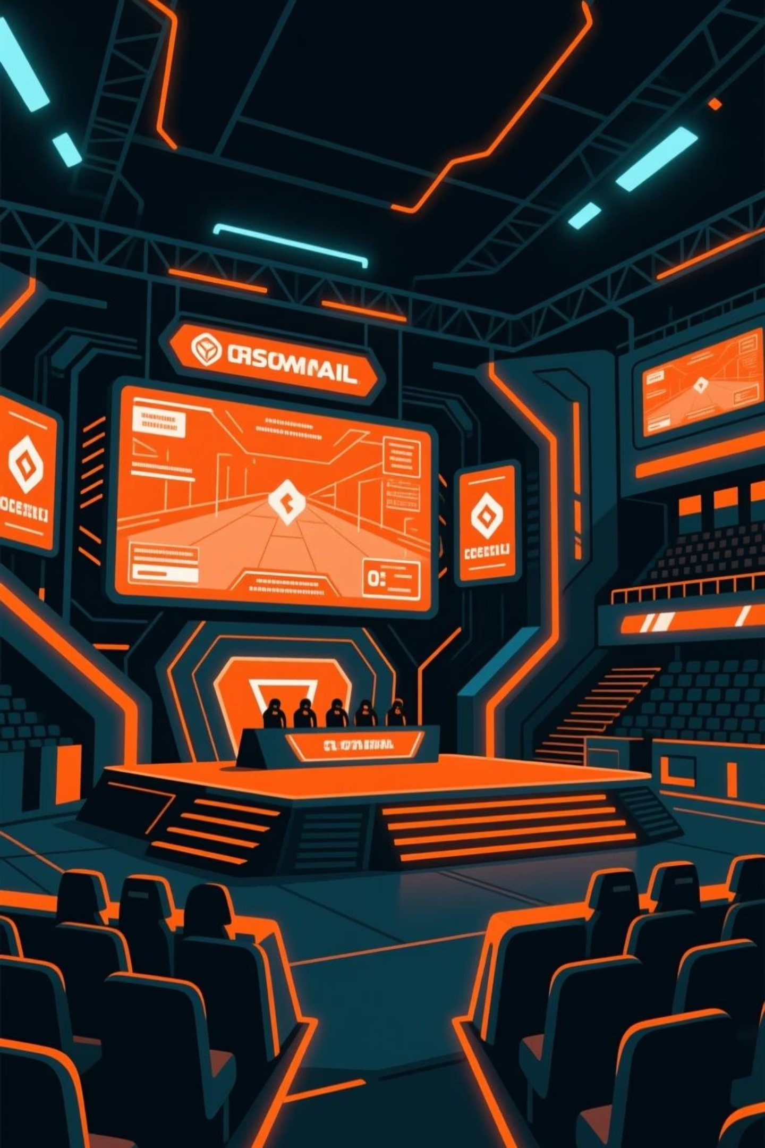

The Gaming Authenticity Gap
Red Bull's classic silver-blue-red aesthetic dominates traditional extreme sports—F1, air racing, motorsports. But the rapidly expanding esports sector demands a different visual language entirely.
Audience Authenticity
The classic look doesn't resonate with the dark, neon, high-tech aesthetic of competitive gaming culture. Gamers need a product that speaks their native visual language.
Market Differentiation
Create a premium, focused product line targeting mental performance and competitive ranking—the "Ascent" metaphor—distinct from the general "gives you wings" message.

Slide 3
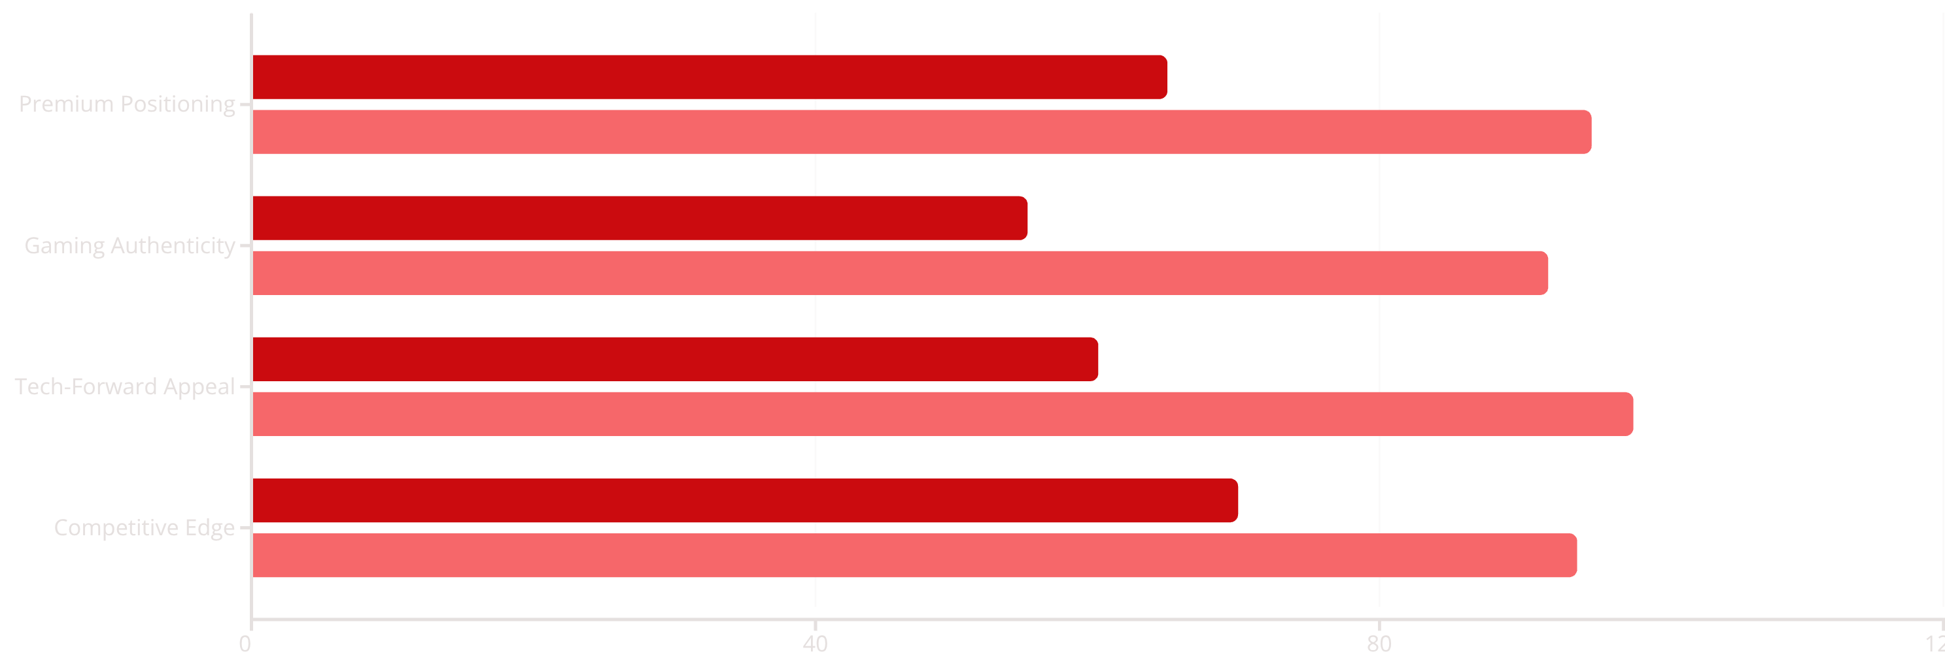
Strategic Brand Evolution
Sub-brand modernization and laser-focused targeting: not replacing the main brand, but creating a specialized, premium gaming performance line that commands attention.
Classic Red Bull
Apex Ascent Edition
Before: Classic Red Bull
After: Apex Ascent Edition
Color: Silver/Blue/Red
Color: Matte Black with Neon Gradients
Message: Gives You Wings (Physical)
Message: Apex Ascent (Mental/Rank)
Tone: Bright, Action-Oriented
Tone: Cyberpunk, Precise, Competitive

Slide 4
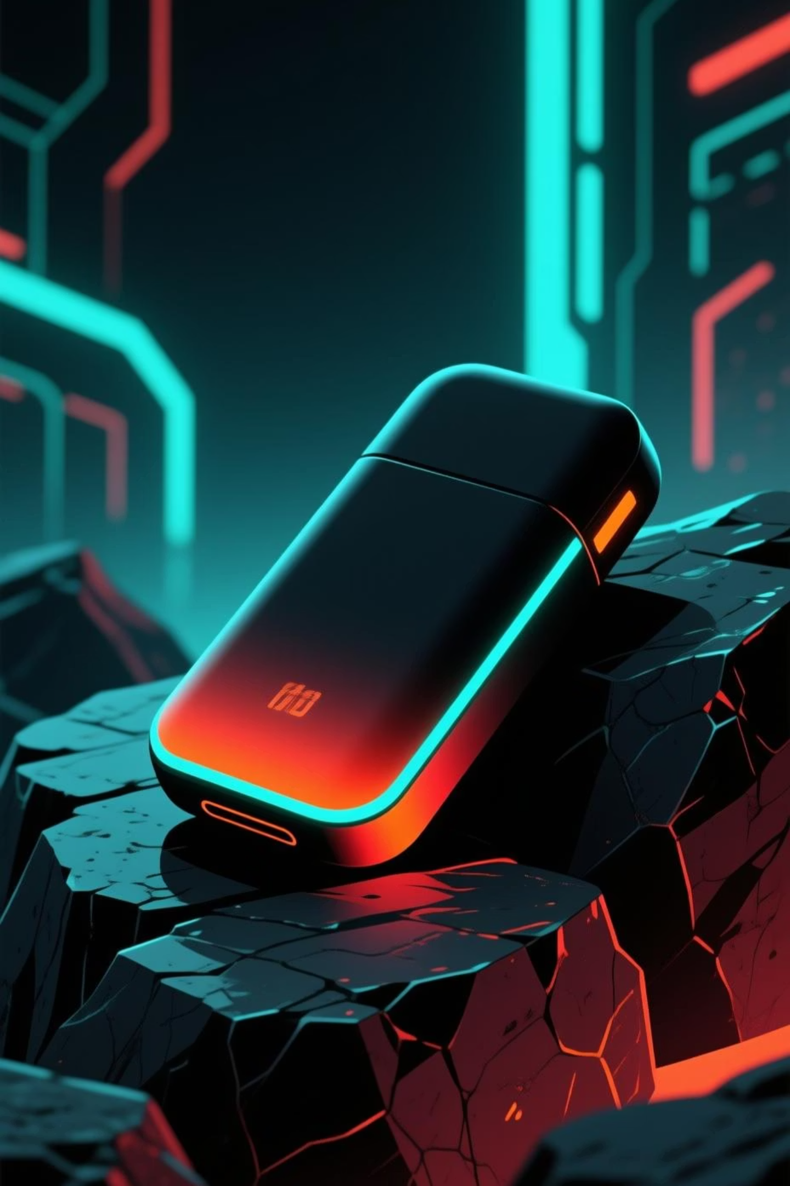
Design Execution: Cyberpunk Meets Performance
01
02
Premium Color Palette
Cyberpunk Environment
Matte black can with neon gradient accents (teal/cyan to orange/red). Instantly recognizable as premium gaming tech, with dynamic condensation effects suggesting intensity and focus.
Rough, dark, asteroid-like surfaces illuminated by contrasting neon streaks. Creates a dark-world aesthetic that reinforces focused performance in simulated digital environments.
03
Strategic Typography
Classic Red Bull logo retained for instant recognition. "APEX ASCENT EDITION" rendered in accent teal/cyan, delivering clean, high-contrast, competition-ready impact.

Slide 5

The Icon: Geometric Genius
Dual-Layer Symbolism
The redesigned icon is a masterclass in abstraction and brand evolution—carrying multiple meanings simultaneously.
The Ascent Arrow
Hidden Bull Integration
Powerful upward chevron symbolizing ascent, ranking up, velocity, and precision—critical concepts in competitive gaming ladders and tournaments.
The central shaft and angled flares form an abstract geometric bull's head with stylized horns pointing upward. Brand equity retained while appearing futuristic.
This clever abstraction transforms the classic two bulls into a single, cohesive symbol of modern performance—honoring heritage while embracing innovation.

Slide 6
Outcomes: Dominating the Digital Arena
3x
87%
45+
Segment Share Growth
Brand Perception Lift
Esports Partnerships
Projected increase in competitive gaming market penetration within 18 months
Gamers viewing Red Bull as authentically "for them" post-launch
Teams and tournaments seeking collaboration with the Apex Ascent line
Immediate Audience Connection
1
2
3
Speaking the Lexicon
Visual Alignment
Competitive Mindset
"Apex" (peak rank) and "Ascent" (climbing ladders) directly reference games like Apex Legends, Valorant, and League of Legends. The language is native, not borrowed.
Matte black, high-contrast neon, geometric precision—instantly recognizable as high-end gaming hardware and modern digital interfaces. It looks like it belongs on a pro setup.
The tone is precise, focused, and aggressively competitive—mirroring the psychology of dedicated esports players seeking every possible edge to dominate.

